Slide 1
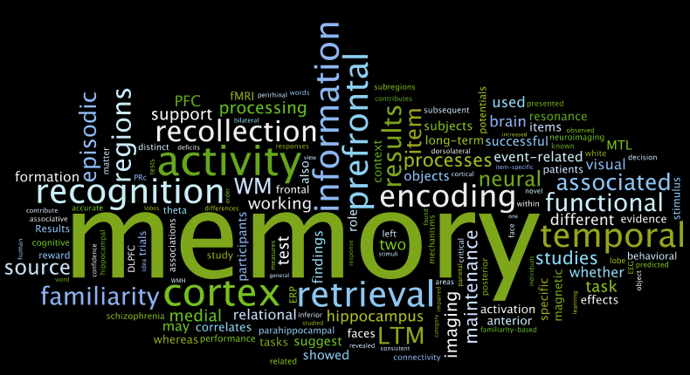

Chapter 4:
Working Memory

Slide 2

Things to Work on
The Early Basics
  What is memory
  Processing stages
  Atkinson & Shiffrin Model
  Influences on STM
Working Memory
  Multi-component: Phological Loop, Visuospatial Sketchpad, Central Executive, Episodic Buffer
Application of Working Memory
  Predictive of academic performance
  Understand differences in clinical populations

Slide 3
3 Stages
Encoding
Transformation of info
Storage
Retention
Retrieval
Recovery
From one form to another
Notes:
Click Encoding:
Click Involves acquiring information and transferring it into memory
Click Storage:
Click Can last anywhere from fractions of a second to several seconds to indefinitely
Susceptible to errors and distortions
Click Retrieval:
Click Just because information has been stored, does not mean it can be easily retrieved

Slide 4
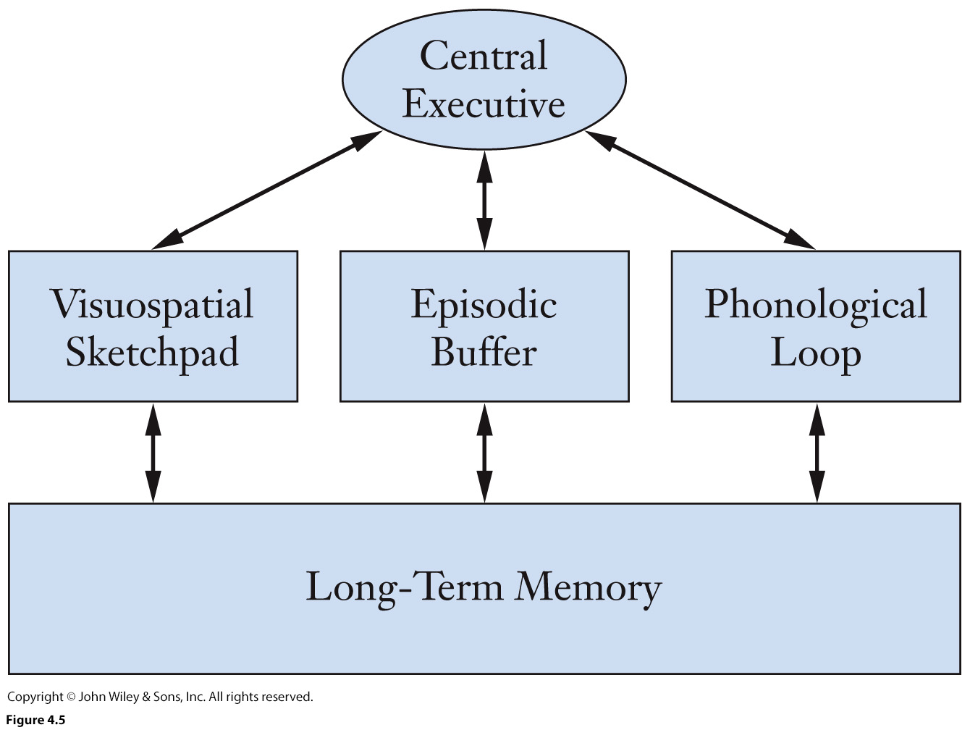
Working Memory Approach
Proposed by Baddeley & Hitch (1974)
  Multi-part system
  Active process
  Manipulates info
Notes:
Proposed by Baddeley & Hitch (1974)
Multi-part system
Active process
Manipulates info - Simultaneous processing and storage!
Each system of working memory operates on specific info.
It’s like workbenches where both new and old information are placed to be manipulated, updated, or discarded.
Still capacity limited and storage time limited
New approach has made some psychologists think that WM & LTM are basically the same thing. Should we divide these are two processes?

Slide 5
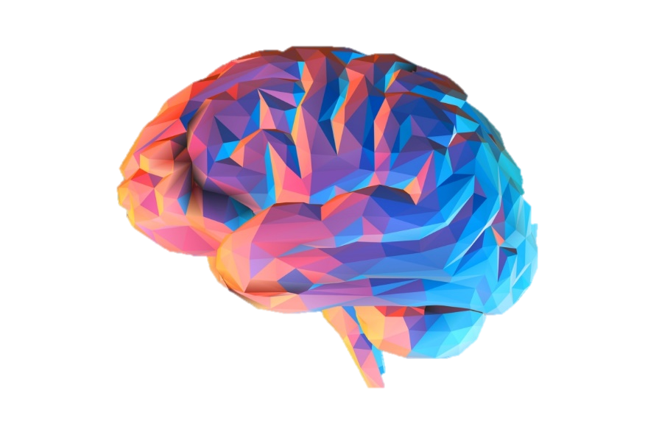
Long-Term Memory
Chapter 5

Slide 6
Points to encode
Basics:
  LTM, 3 subdivisions, Encoding, Retrieval
Encoding
  Depth of Processing (distinctiveness & elaboration)
  Encoding-Specificity (cues & context)
  Emotional Context (Pollyanna Principle)
Retrieval
  Explicit vs Implicit
Autobiographical Memory
  Reconstruction, schemas, source & reality monitoring
  Post-misinformation, retroactive interference
  Flashbulb & false memories
  Priming, Expertise
  Amnesia

Slide 7
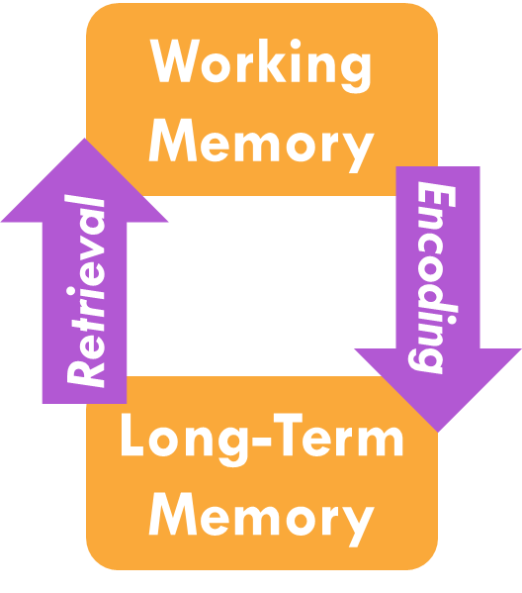
Two aspects of LTM
Encoding:
  Process info to store into LTM
Retrieval:
  Locate info stored in LTM
  Source of typical memory errors
Notes:
click encoding & retrieval:
Encoding:
Click Process info to store into LTM
Retrieval:
Click Locate info stored in LTM
Click Source of typical memory errors – meaning the memory is likely encoded but your retrieval strategy was inaccurate to access it.
When studying these processes of LTM in subjects, its near impossible to separate the two. A response on a memory task will require you retrieving that memory suggesting, it’s difficult to understand how you encoded without allowing this step to take place.

Slide 8

Altering your knowledge:
Social Media
Repeated statements:
Rated as more true
Feel more true even if against one’s knowledge
  Not protected by prior knowledge
Less credible info:
  Still likely to remember false info
  Likely to forget info is false
Dechêne, Stahl, Hansen, & Wänke (2009), Fazio, Brashier, Payne, & Marsh (2015), Henkel & Mattson (2011)
https://theconversation.com/unbelievable-news-read-it-again-and-you-might-think-its-true-69602
Notes:
Can we protect against misleading info in our current media society?
[click]
Study by Dechêne, Stahl, Hansen, & Wänke (2009) in Society for Personal and Social Psychology (journal)
Key finding: Subjects rate repeated statements they read as more true then new statements
In a typical study, participants read a series of true statements (“French horn players get cash bonuses to stay in the U.S. Army”) and false ones (“Zachary Taylor was the first president to die in office”) and rate how interesting they find each sentence. Then, they are presented with a number of statements and asked to rate how true each one is. This second round includes both the statements from the first round and entirely new statements, both true and false. The outcome: Participants reliably rate the repeated statements as being more true than the new statements.
You’d think this effect is limited to things we know nothing about:
Henkel & Mattson (2011)
[click]
Prior knowledge does not protect people from illusory truth
Repeated statement feel more true even if against one’s knowledge
For example, even among people who can identify the skirt that Scottish men wear as a kilt, the statement “A sari is the skirt that Scottish men wear” is rated as more true when it is read twice versus only once. On a six-point scale, the participants’ truth ratings increased by half a point when the known falsehoods were repeated. The statements were still rated as false, but participants were much less certain, rating the statements as “possibly false” rather than closer to “probably false.”
Henkel & Mattson (2011)
[click]
People still likely to remember false info
Also likely to forget info is false
People tend to remember false information, but forget that it was labeled as false. A 2011 study gave participants statements from sources described as either “reliable” or “unreliable.” Two weeks later, the participants were asked to rate the truth of several statements – the reliable and unreliable statements from before, and new statements as well. They tended to rate the repeated statements as more true, even if they were originally labeled as unreliable.
Thanks to rapid sharing online media people get their information from, your generation is probably most at risk of falling prey to the availability heuristic.
SOLUTION:
A true solution would be to somehow limit the spread of these inaccurate or false claims, preventing people from seeing them in the first place. A first step that each of us can take is to check our sources and not share unreliable articles on social media, even if they affirm our beliefs.

Slide 9
Eyewitness Testimony
Past info (LTM)
Time of mem.
Source monitoring
Misinformation
Retroactive Interf.
Schemas
Current Knowledge;
Recollection of event
Social pressure
Context
Own ethnicity bias
Emotions
e.g., Stress
Present info (WM)
Notes:
Click
Past info (LTM)
Time of mem. – farther more decay of memory! Reconstruction issue…contaminate memory!
Click
Present info (WM)
Click
Schemas
Click
Source monitoring
Misinformation – especially if information seems plausible
Retroactive Interf. – overwriting knowledge that you had, or introducing knowledge you did not have
Click
Own ethnicity bias
Click
Context – encoding specificity
Click
Emotions
e.g., Stress – reduces accuracy of mem
Click
Social pressure – more accurate when allowed to report in own words and say “I don’t know”
Encouragement makes people feel more confident in their memories….juries and officers believe more “confident” witnesses!

Slide 10
Main points
LTM: complex, fluid, & adaptive
Two step process: Encoding & Retrieval
  Each affected by different factors
Diff types of mem. for diff things
Memories susceptible to many distortions
Emotion & context affect retrieval
Notes:
click LTM is complex, fluid, & adaptive
click Two step process: Encoding & Retrieval
Each affected by different factors
click Different types of memories for different things
click Memories are susceptible to many distortions
click Emotion & context can affect retrieval
Final memory demo here

Slide 11

Memory Strategies & Metacognition
Chapter 6

Slide 12
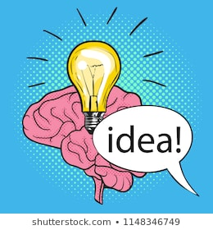
Meta-Outline
Remembering the basic
  Elaboration, Distinctiveness, Rehearsal, Self-reference effect, & Encoding Specificity
Practice & Mnemonics
Metamemory:
  TOT, FK, Metacomprehension
  Practice:
    Distributed vs total time
    Testing Effects
  Imagery: Visual, keyword, loci
  Organization:
    Hierarchy, first letter, narrative
  Prospective memory

Slide 13



Mnemonic Strategies Examples
Visual Imagery
Method of Loci
Keyword Method
First-Letter Technique
Narrative Technique
Hierarchy Technique
  E.g., Outlines or Concept Maps
Notes:
ALE: groups define mnemonics & apply them to randomly assigned class material

Slide 14
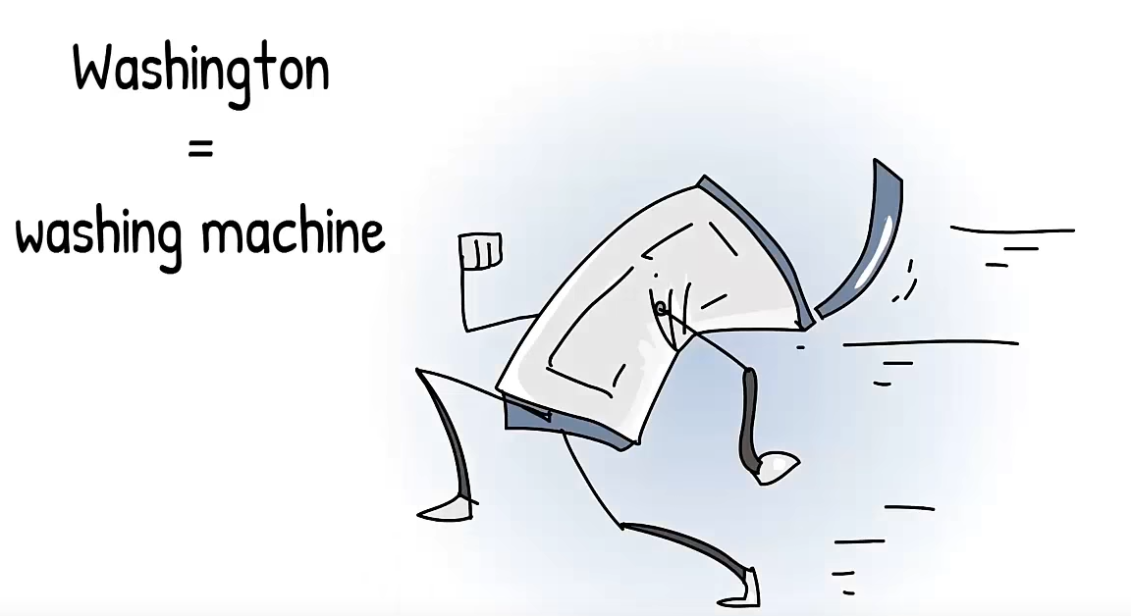
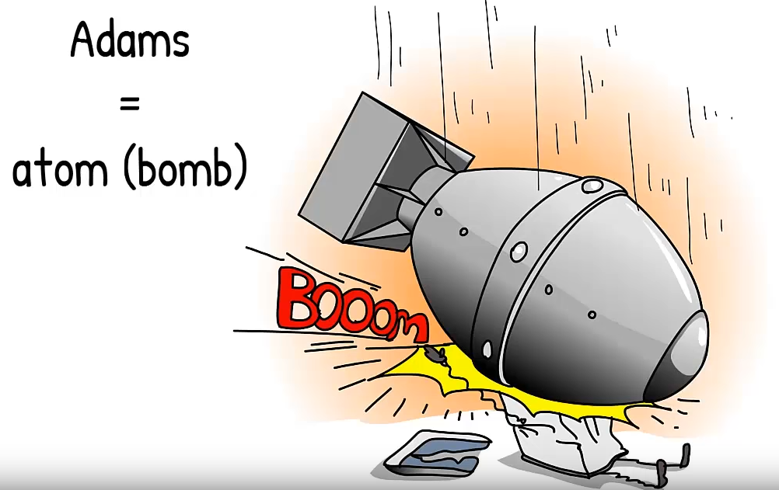
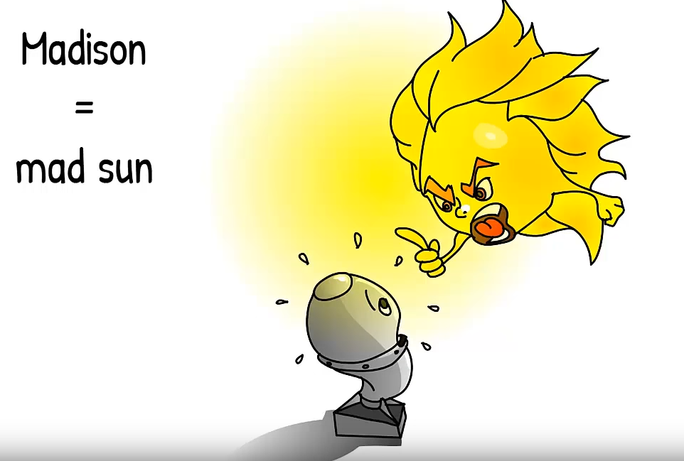
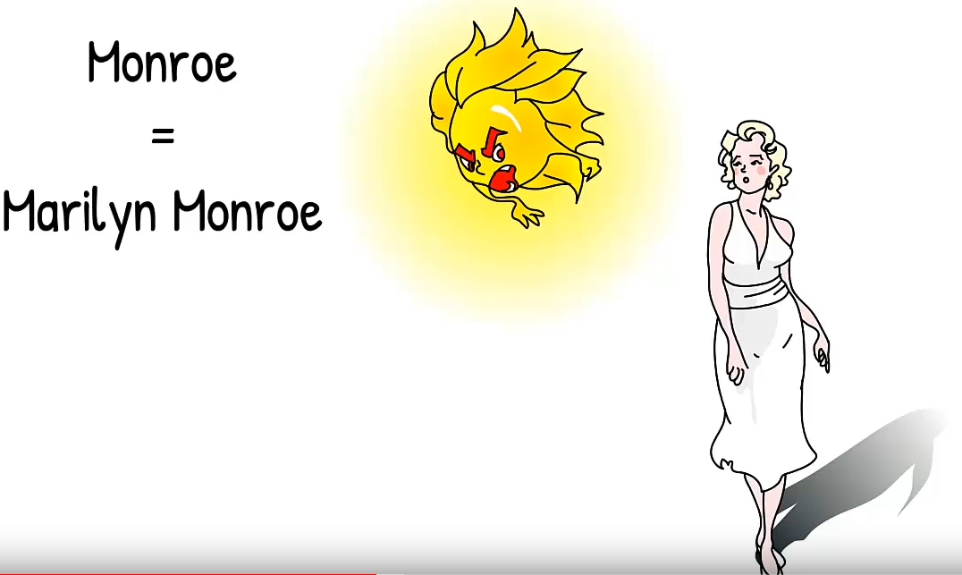
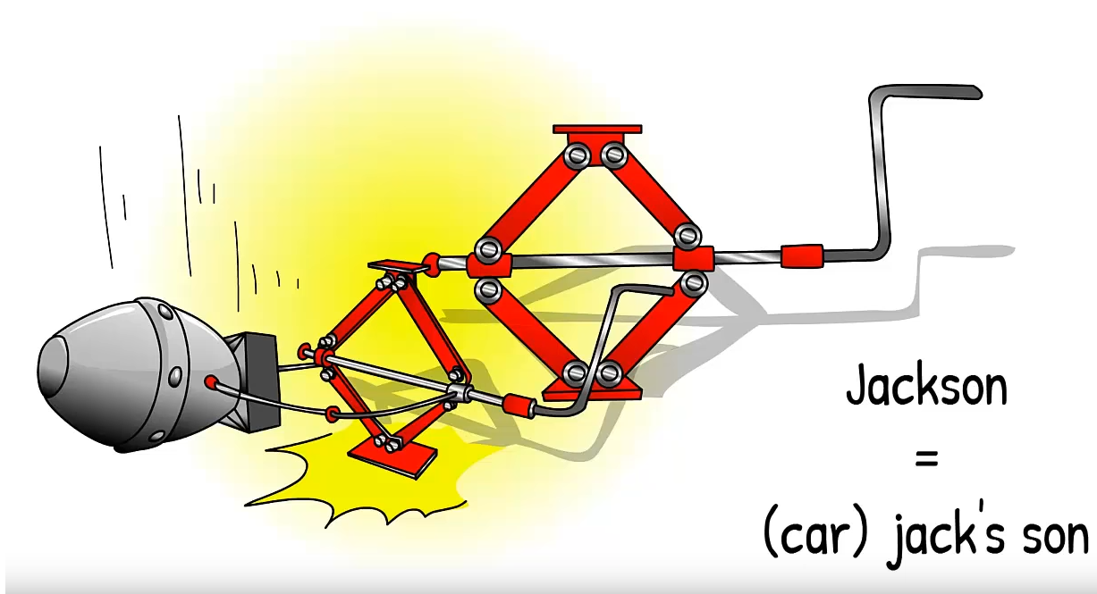
Mnemonic Imagery: Keyword Method
Keyword Method
  Vocabulary learning or names
  Link similar sounding keyword to new word
Notes:
Keyword Method
Vocabulary learning or names
Link similar sounding keyword to new word

Slide 15
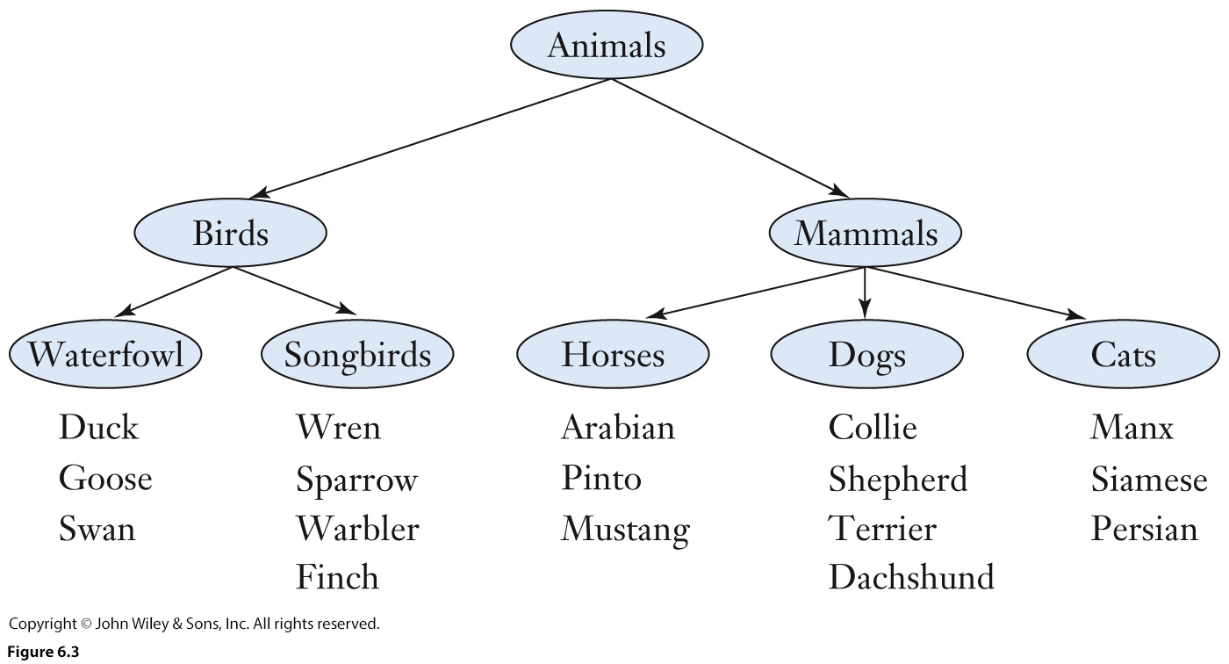
Mnemonic Organization: Hierarchy Technique
Create semantic order
Hierarchy Technique
  Arrange info into meaningful classes
  Move from general to specific cases
Outlines
Concept maps
  Connect ideas
Notes:
Create semantic order
Click Hierarchy Technique
Arrange info into meaningful classes
Click Move from general to specific cases
Click Outlines
Concept maps
Connect ideas

Slide 16
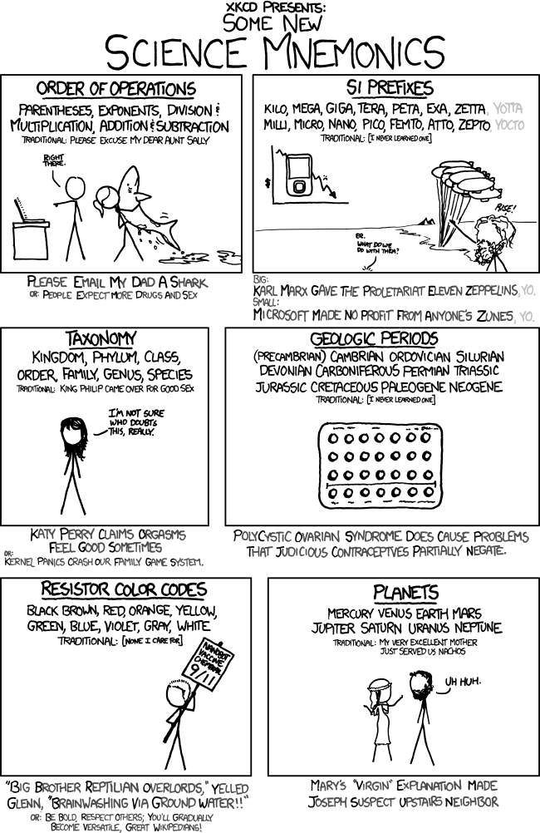
Mnemonic Organization II: Classic Method
First-Letter Technique
Why?
  Letters are cues
  Info is Chunked
  Distinctiveness
  Deeper semantic
Notes:
Q: why does it work? What memory concepts can you think of that makes this reorganization effective?
click Letters are cues
click Info is Chunked
click Distinctiveness
click Deeper semantic

Slide 17
Mnemonic Organization III: Narrative Technique
Narrative Technique
  Form stories linking info
  Effective if can reliably regenerate story
  Combine with Method of Loci

Slide 18
Reflect
Consider all the strategies we’ve discussed
What do you currently do?
Implement two or three methods into your studying!
  Recite info you learn in class
  Use mnemonics
  Practice one hour a day
  Make and take your own practice test
Notes:
Consider all the strategies we’ve discussed
What do you currently do?
Implement two or three methods into your studying!
click
Recite info you learn in class
Use mnemonics
Practice one hour a day
Make and take your own practice test

Slide 19



General Knowledge
Chapter 8

Slide 20
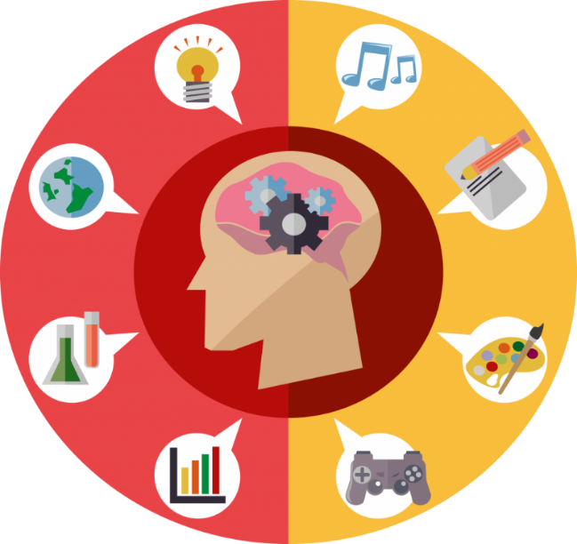
Catalogue of topics
Theories of Knowledge Storage
  Semantic -Interpretation, prediction, & inference
  Situated Cognition; Categories & Concepts
  Prototype vs Exemplar Approach
Cognitive Models of Knowledge Storage
  Connectionist model: PDP, S.G., D.A., G.D.
Schemas & Scripts
  Heuristic, influences memory
  Boundary extension, abstraction
  Constructive vs pragmatic approach
  Memory integration & stereotyping

Slide 21

Semantic:
Categories & Concepts
CONCEPT
Obj.
Elements / Members
Combine many obj. together with single concept
Category
Details
Details
…
Obj.
Obj.
….
Notes:
Click concept
Click category
Click obj in category
Click elements

Slide 22
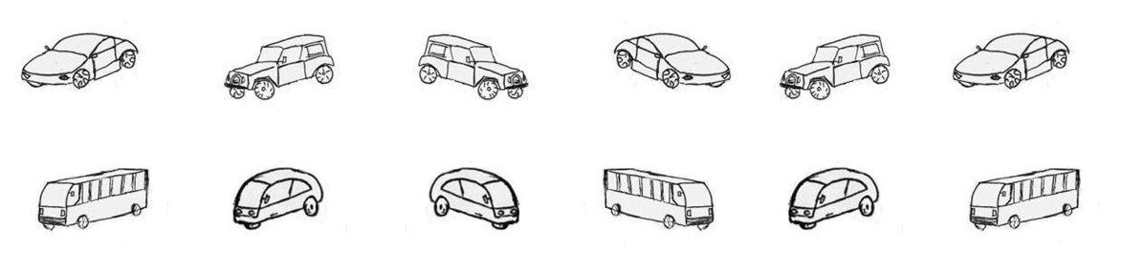
Prototype Approach
Main Points
Most typical member represent category
  Concept – mental rep of category
Resemblance → new membership
Members & attributes are graded
No one single attribute in common
No clear boundaries
Notes:
Most typical member represent category
Concept – mental rep of category
Resemblance of new items to prototypes → determines new membership
Members & attributes are graded; prototypicality
No one single attribute in common; but each member shares at least one attribute with another
No clear boundaries as to what does or does not belong

Slide 23
Exemplar Approach
Learn examples of members in a category
Compare new items to “all” stored members
Ex.
Ex.
Ex.
Concept
New item
Ex.
Notes:
Learn examples of members in a category
Compare new items to “all” stored members
Click exemplar
Click concept
Click new item
Click compare
How we might learn new abstract categories

Slide 24
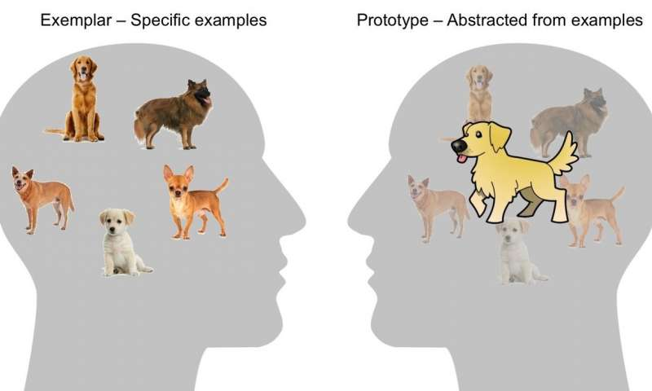
Exemplar vs Prototype
Notes:
Prototype is like an averaging of the different attributes each member or element posses
Exemplar contains all the members, and you compare for similarity
Likely diff categories use diff strategies.
Both active?

Slide 25
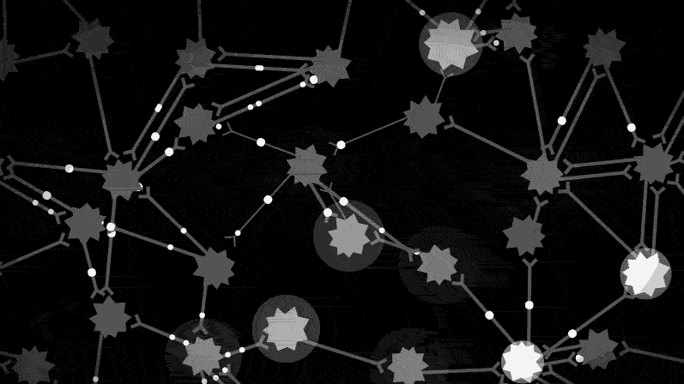
Understanding PDP
Concepts = network/pattern of neural activity
  i.e., node + connections
Notes:
Concepts = network of neural activity
i.e., node + connections

Slide 26
Graceful Degradation
Cue 4
Cue 1
Missing
TARGET
Cue 2
Cue 3
Notes:
Cue 1 & 2, especially in unison, give rise to target information being retrieved
Cue 3 & 4 give a familiar sense of the target but not enough to bring it to memory

Slide 27
Main Points:
Schemas & Scripts
Influence how material stored
  Mental shortcuts, quick decisions
Can result in false reconstructions
Abstraction: exact details of a message not typically stored
  Pragmatic Approach: verbatim storage does occur; goal-relevant situations
Potential stereotyping explanation:
  Influence of implicitly held schemas

Slide 28
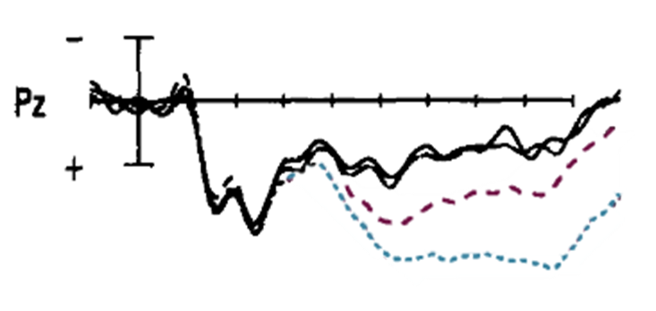
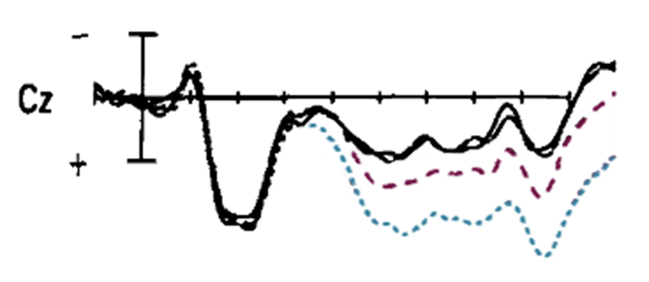
Measuring Internal Associations
Neuroscientific method:
  The [man / woman] prepared [himself / herself] for the interview
  The [nurse / doctor] prepared [himself / herself] for the operations
Notes:
Book discusses: Osterhout et al (1997)
study looking at processing sentences that had stereotypical and non stereotypical sentences.
EG: click The nurse prepared [himself / herself] for the operation
EG: click The Doctor prepared [himself / herself] for the operation
Compared it to neuro behavior when reading pronoun matched or mismatched sentences
The [man / woman] prepared [himself / herself] for the interview
Click
parietal & central midlines (other areas also measured)
Used ERP to see differences in electrical activity in the brain.
Black line – no mismatch between man/doctor – himself; nurse/woman – herself (no surprise)
Blue line – mismatch: man – herself; woman – himself
Purple line – mismatch: doctor – herself; nurse - himself
Click Recent 2009 paper → same results

